Slide 1
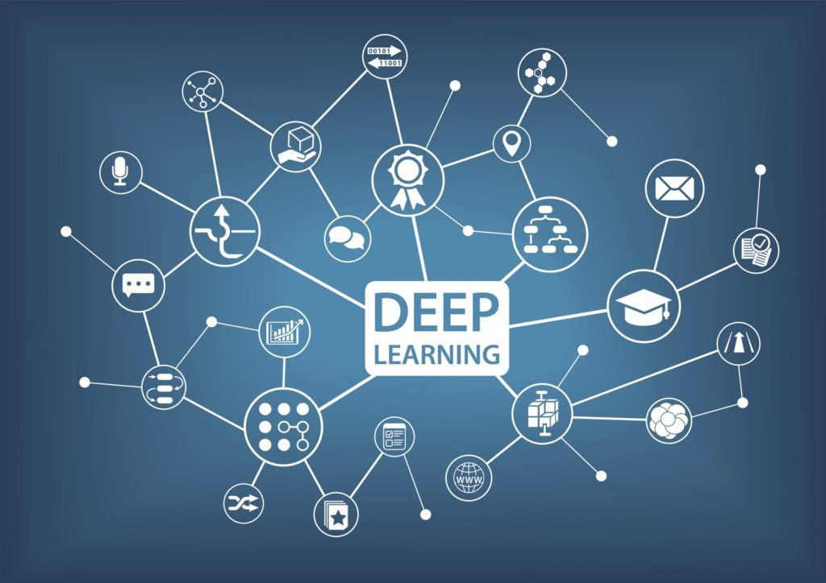

Slide 2
What is Deep Learning?
Deep learning is a machine learning technique that teaches computers to do what comes naturally to humans: learn by example.
Deep learning is a key technology behind driverless cars, enabling them to recognize a stop sign, or to distinguish a pedestrian from a lamppost. It is the key to voice control in consumer devices like phones, tablets, TVs, and hands-free speakers.
Deep learning is getting lots of attention lately and for good reason. It’s achieving results that were not possible before

Slide 3
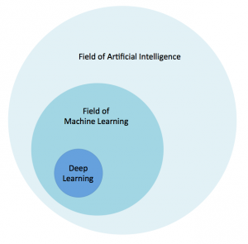

Slide 4

Artificial Intelligence
(AI) refers to the simulation of human intelligence in machines that are programmed to think like humans and mimic their actions. The term may also be applied to any machine that exhibits traits associated with a human mind such as learning and problem-solving.

Slide 5

What is Machine Learning?
Machine learning is an application of artificial intelligence (AI) that provides systems the ability to automatically learn and improve from experience without being explicitly programmed. Machine learning focuses on the development of computer programs that can access data and use it learn for themselves.

Slide 6


Slide 7
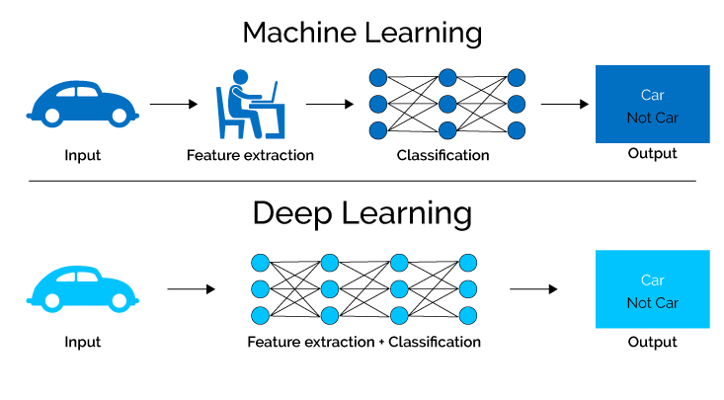

Slide 8
Why is Deep Learning Important?
Deep Learning is important for one reason, and one reason only: we’ve been able to achieve meaningful, useful accuracy on tasks that matter. Machine Learning has been used for classification on images and text for decades, but it struggled to cross the threshold – there’s a baseline accuracy that algorithms need to have to work in business settings. Deep Learning is finally enabling us to cross that line in places we weren’t able to before.
Computer vision is a great example of a task that Deep Learning has transformed into something realistic for business applications. Using Deep Learning to classify and label images isn’t only better than any other traditional algorithms: it’s starting to be better than actual humans.

Slide 9
Why Deep Learning Matters
In a word, accuracy. Deep learning achieves recognition accuracy at higher levels than ever before. This helps consumer electronics meet user expectations, and it is crucial for safety-critical applications like driverless cars. Recent advances in deep learning have improved to the point where deep learning outperforms humans in some tasks like classifying objects in images.

Slide 10
There are two main reasons it has only recently become useful.
Deep learning requires large amounts of labeled data. For example, driverless car development requires millions of images and thousands of hours of video.
Deep learning requires substantial computing power. High-performance GPUs have a parallel architecture that is efficient for deep learning. When combined with clusters or cloud computing, this enables development teams to reduce training time for a deep learning network from weeks to hours or less.

Slide 11
How Deep Learning Works
Most deep learning methods use neural network architectures, which is why deep learning models are often referred to as deep neural networks.
The term “deep” usually refers to the number of hidden layers in the neural network. Traditional neural networks only contain 2-3 hidden layers, while deep networks can have as many as 150.
Deep learning models are trained by using large sets of labeled data and neural network architectures that learn features directly from the data without the need for manual feature extraction.

Slide 12
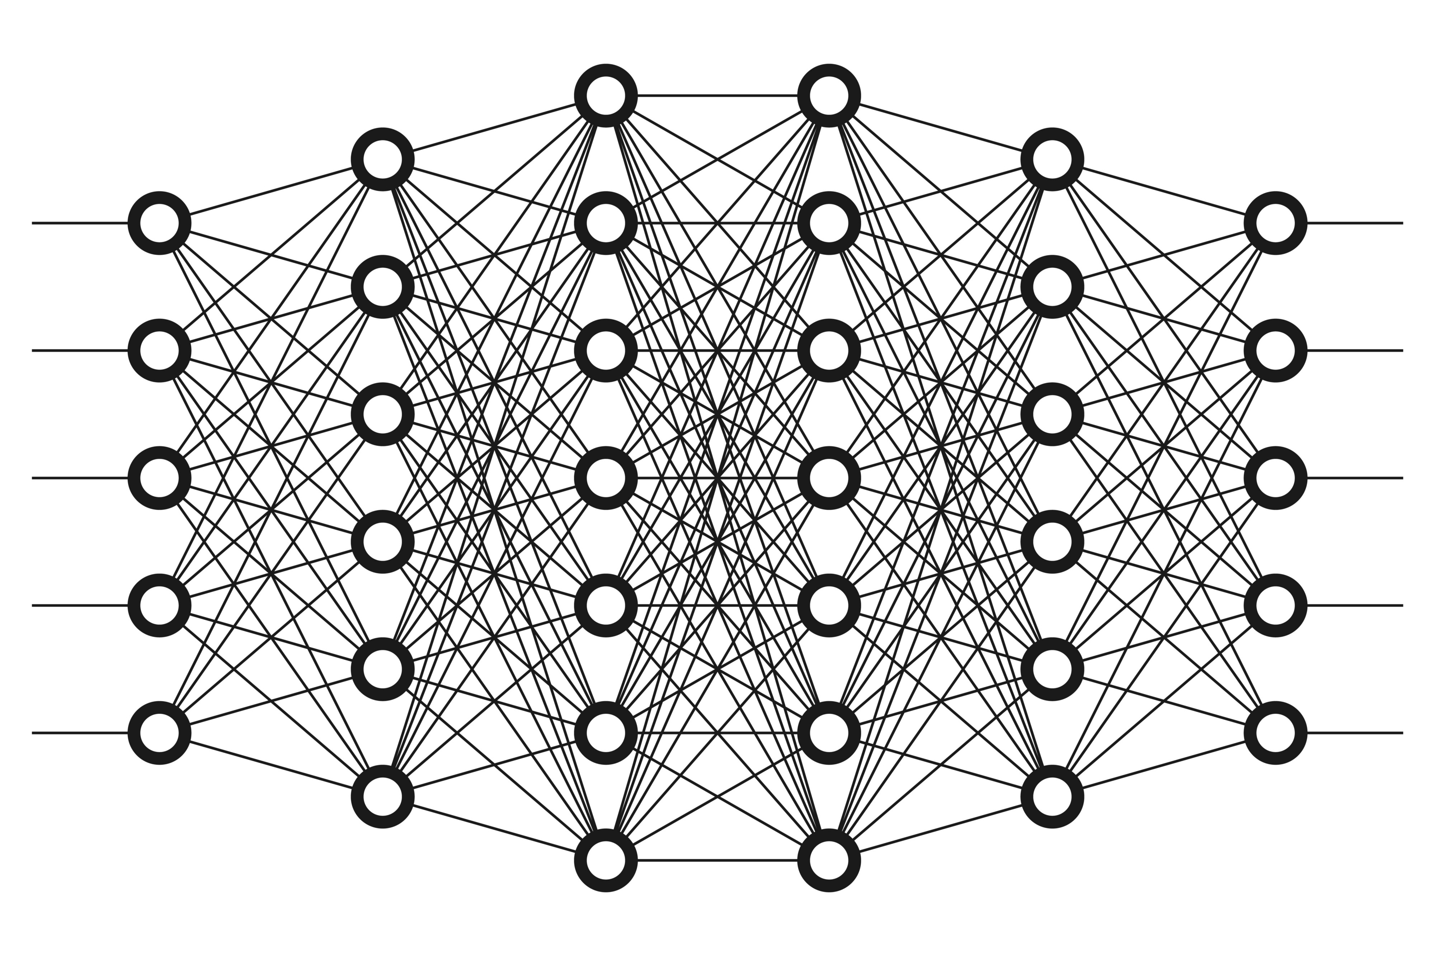

Slide 13
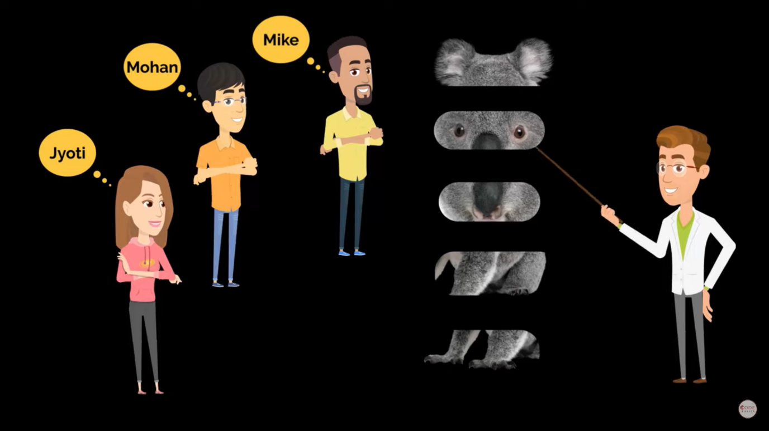

Slide 14
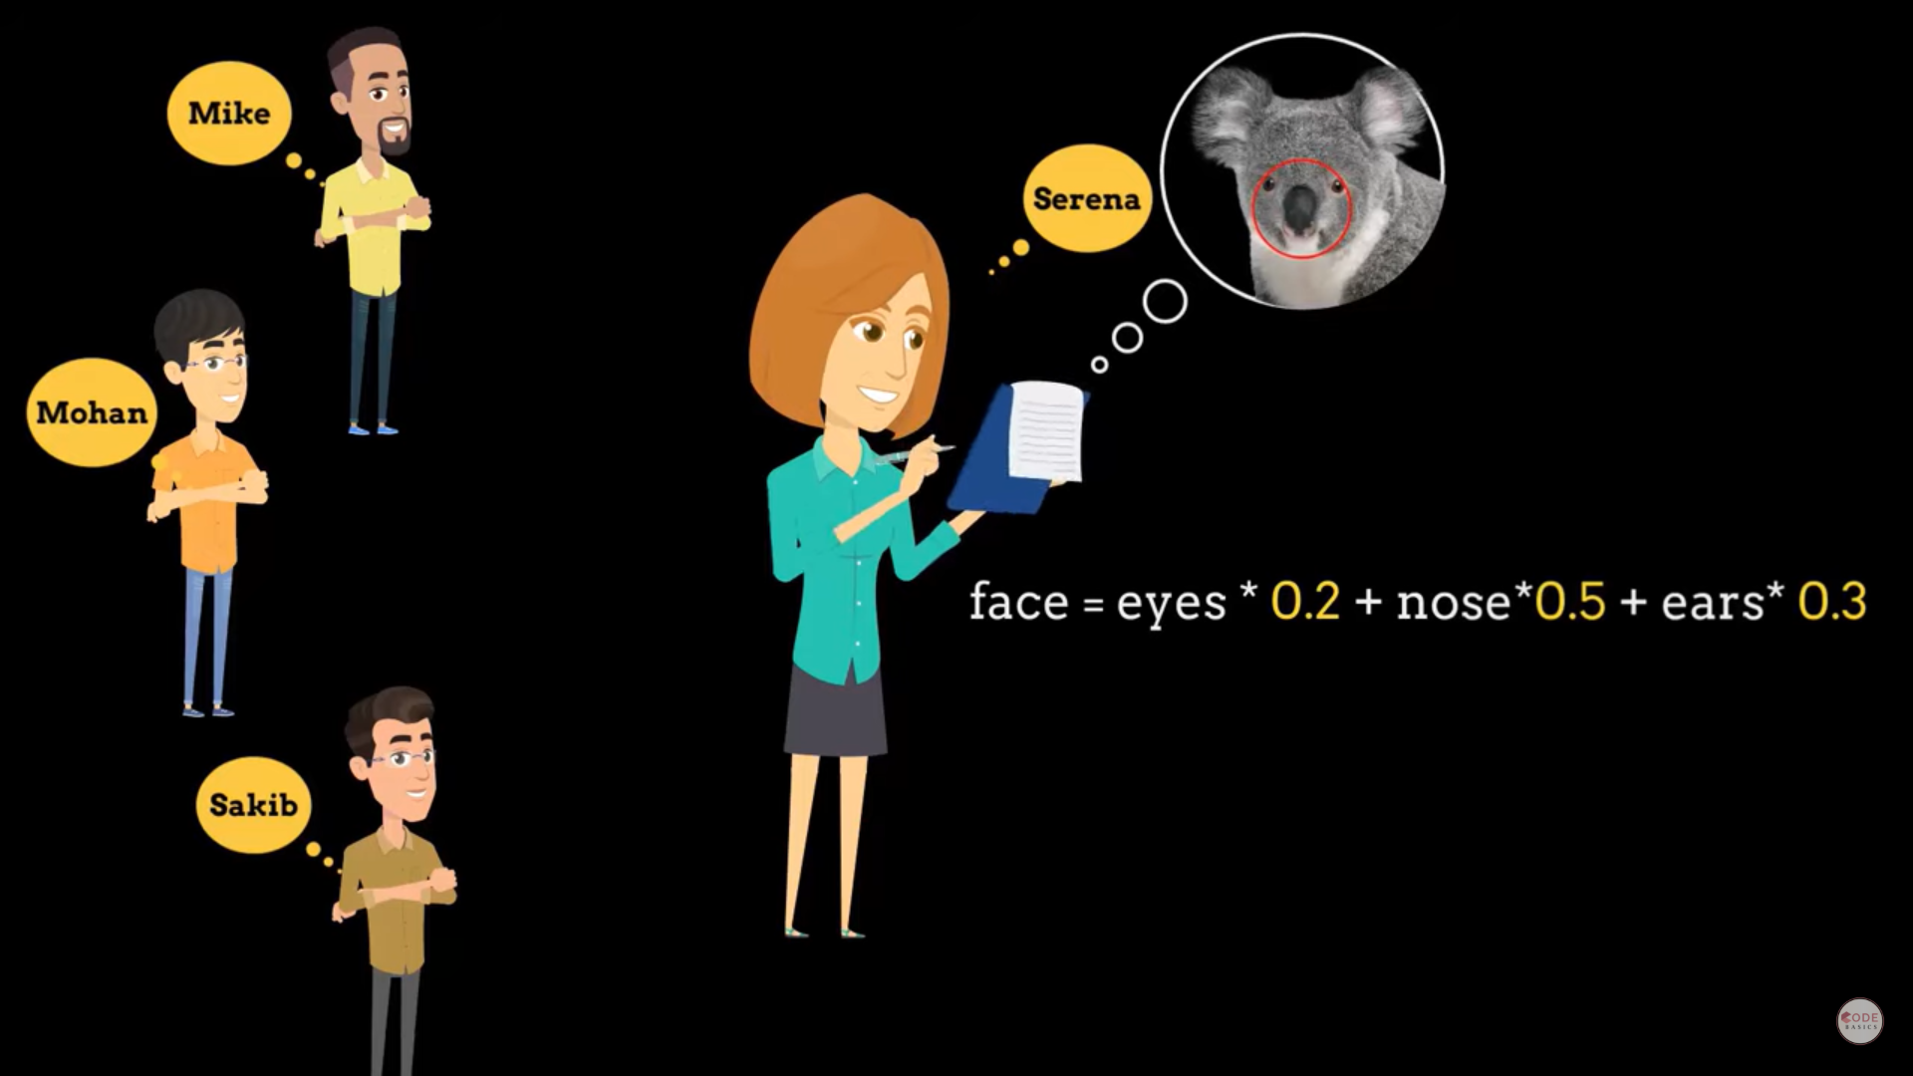

Slide 15
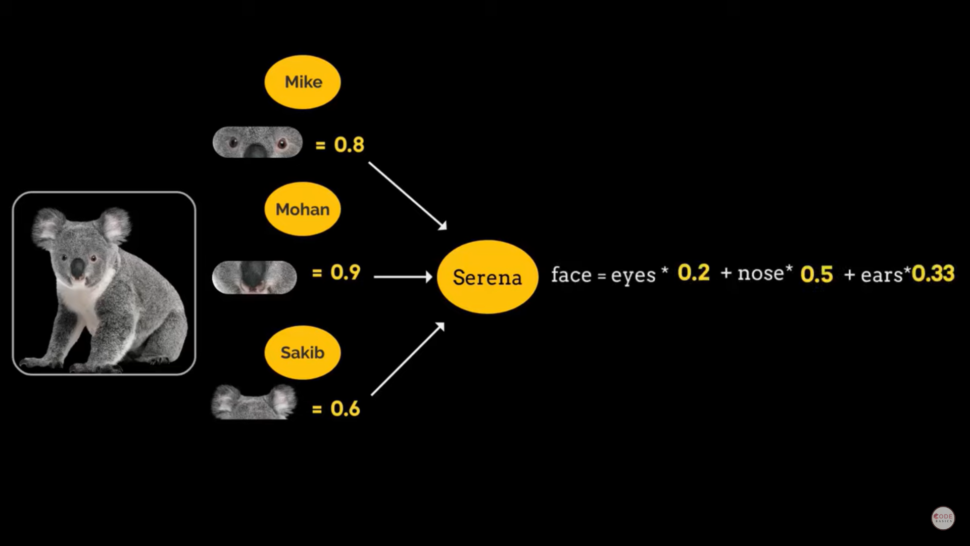

Slide 16
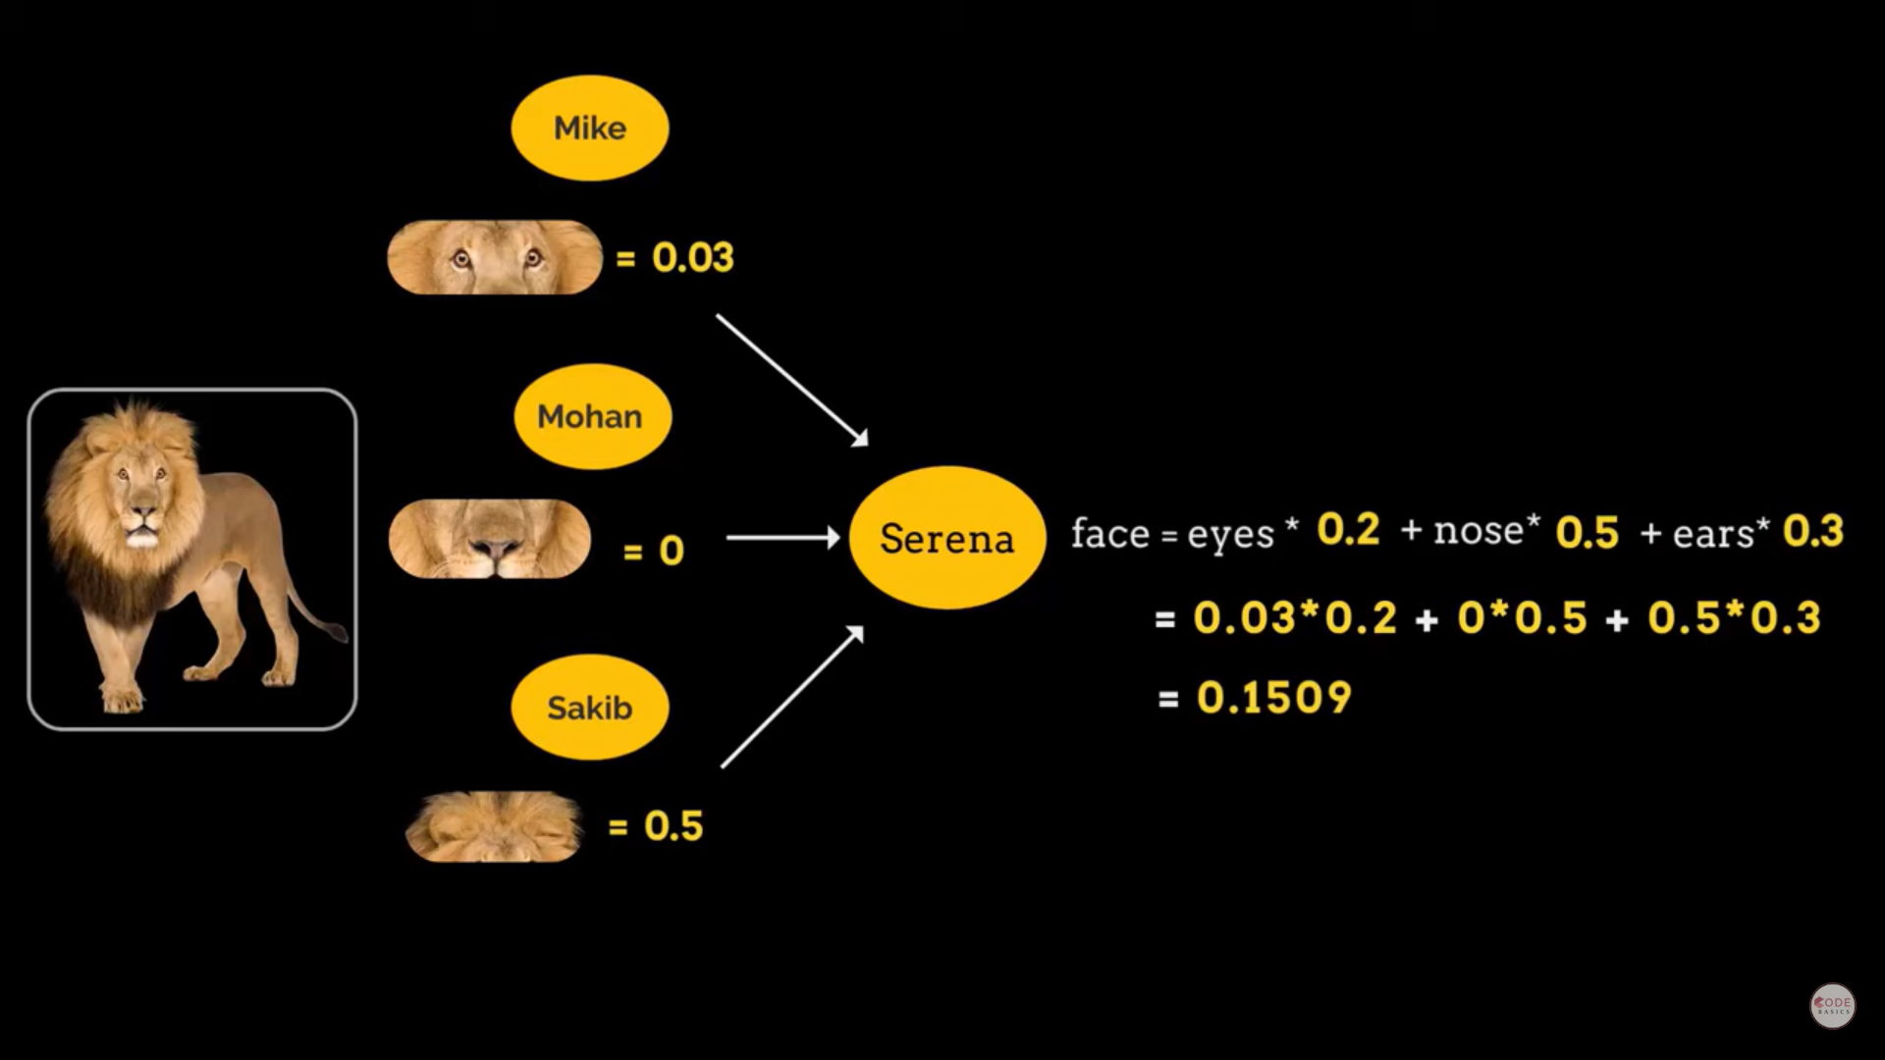

Slide 17
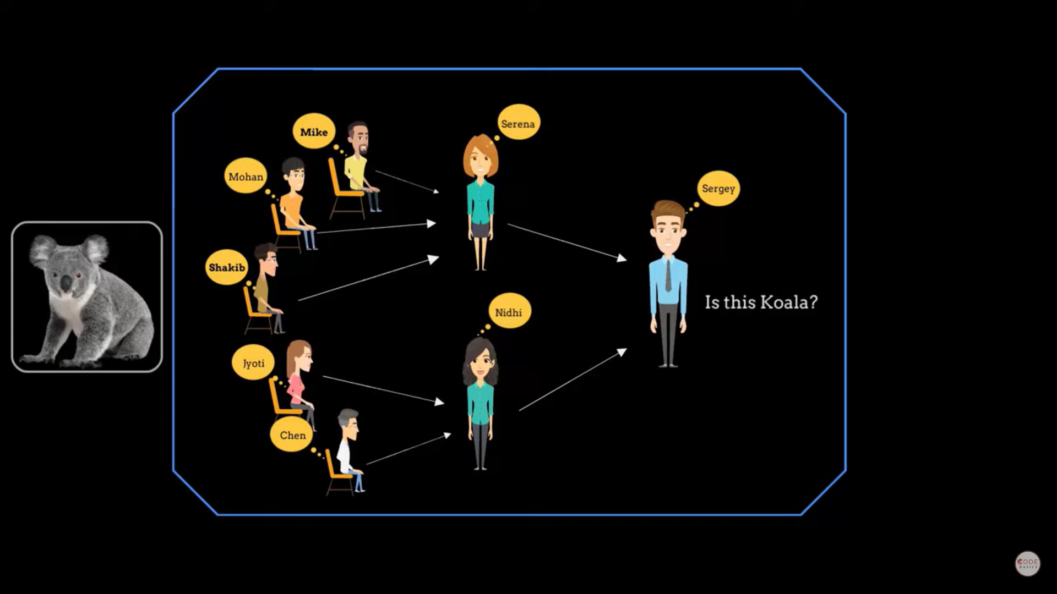

Slide 18


Slide 19
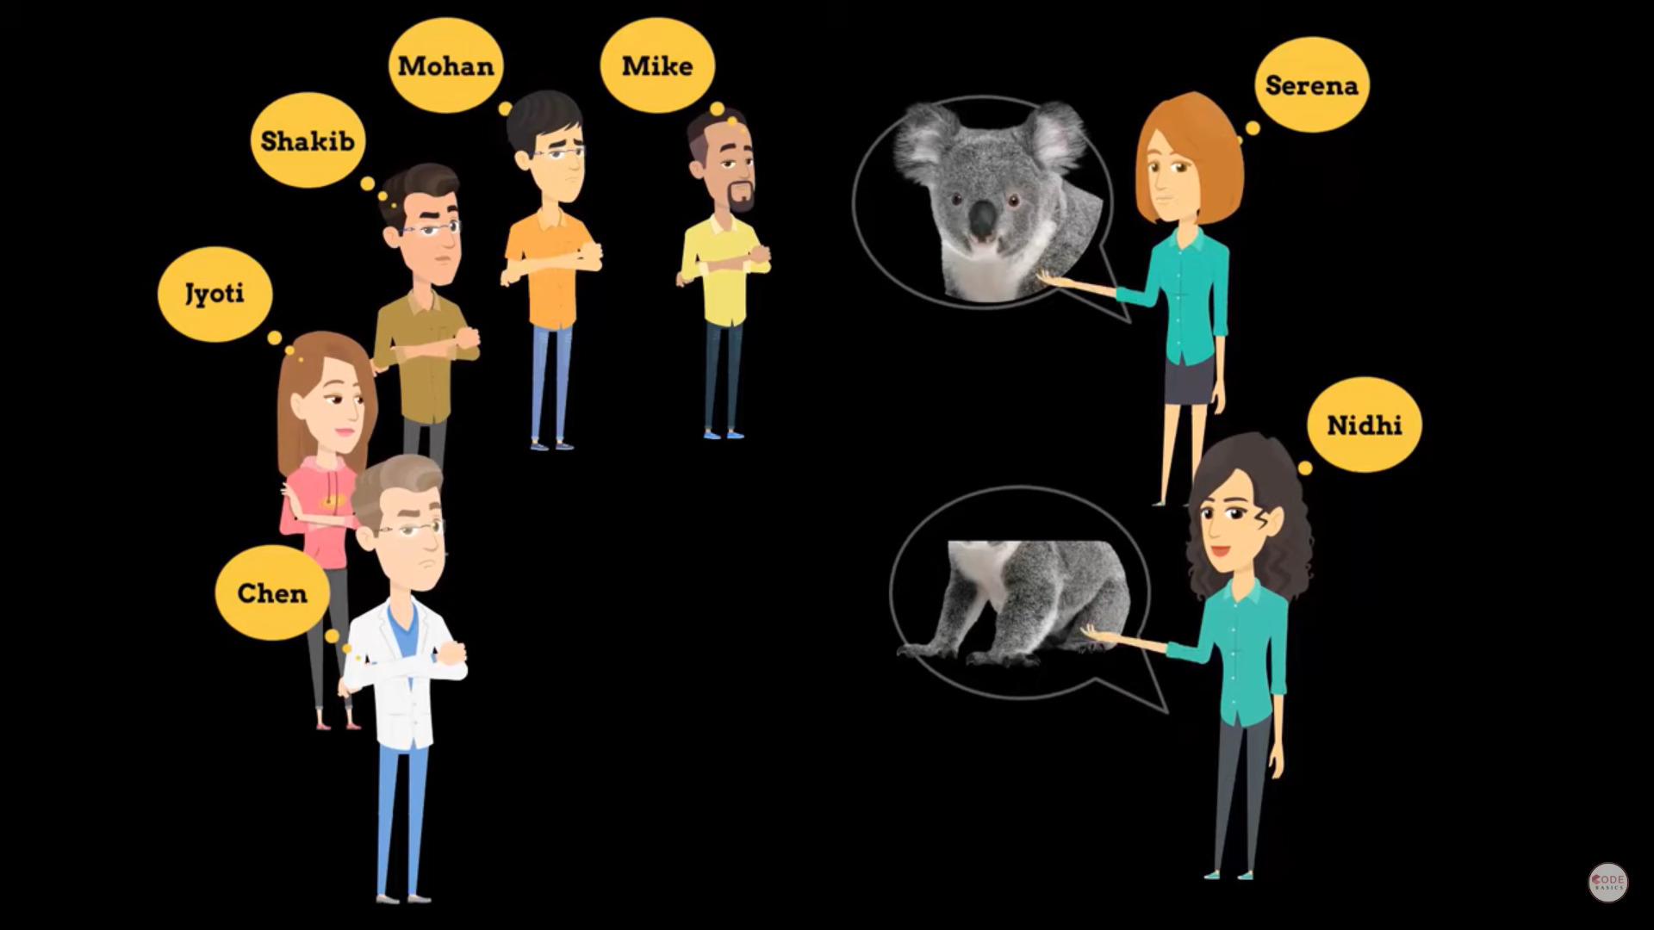

Slide 20
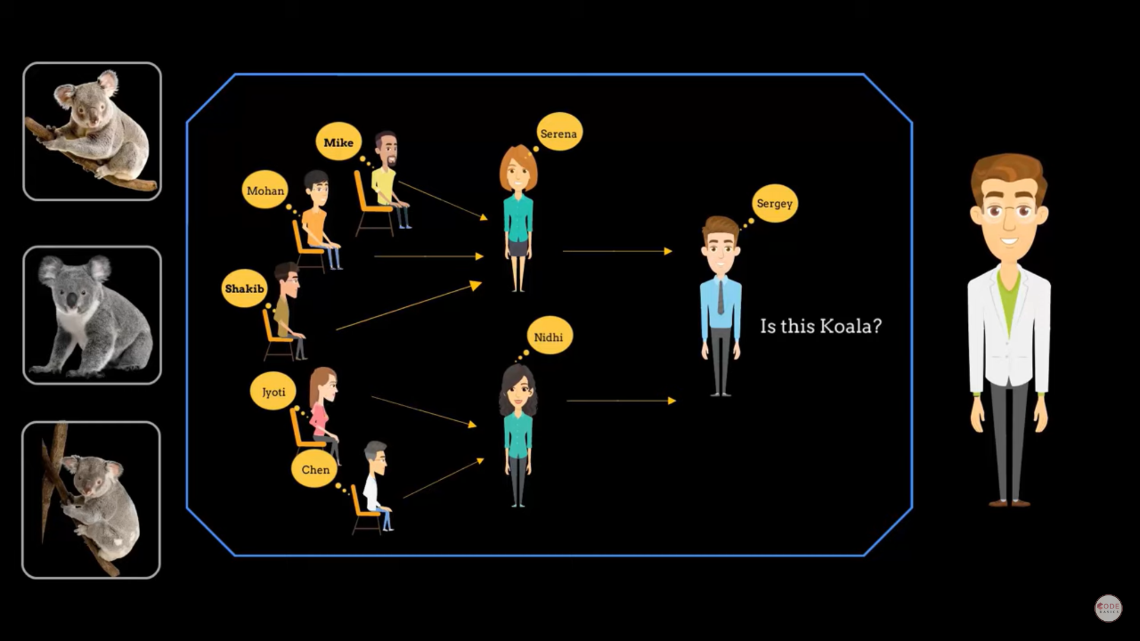

Slide 21
Where Deep Learning Can Be used?
Customer experience
Translations
Adding colour to black-and-white images and videos
Language recognition
Autonomous vehicles
Computer vision
Text generation
Deep-learning robots

